Slide 1
Session 6 – High Dimensional Fixed Effects Data Skills for Research Kellogg Research Support
August 17, 2023

Slide 2

Fixed Effects
Fixed effects / group-specific intercepts are frequently used in econometric models:
Get rid of omitted variable bias
Handle potential unobserved heterogeneity
Increase precision

Slide 3

Fixed Effects
Whenever you think there might be an extraneous influence on subsets of your data, you can control for it using a ‘fixed effect’
A catch-all variable that represents the net effect of all extraneous influences
Mechanically, a full set of dummy variables, one for each subgroup
The term ‘fixed effects’ originated in the panel data literature – here, you observe individual entities in multiple time periods, and each entity is the ‘subset’
But ‘fixed effects’ is nowadays often used more widely, whenever you ‘dummify’ subgroups of your data – potential for jargon confusion
Notes:
https://twitter.com/nickchk/status/1067136328859439104?s=20

Slide 4

Roadmap
Why use Fixed Effects?
How to deal with “too many” fixed effects
de-meaning variables
Data Examples and Computational Horse Races
Stata
R
Python
Parallelizing Fixed Effect Code on KLC

Slide 5
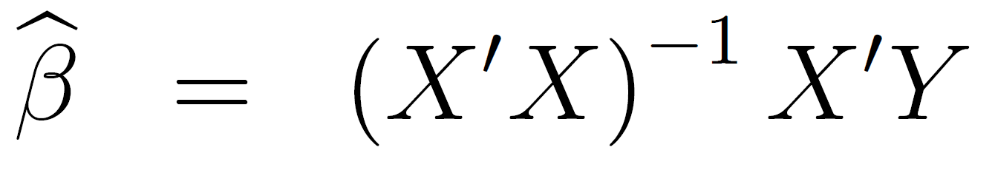
But that’s what we have computers for, isn’t it?
An important equation:
X’X is a k by k matrix, where k is the number of regressors
What does this mean if you have tens of thousands of fixed effects??

Slide 6
Frisch, Waugh and Lovell to the rescue
It turns out that including a full set of fixed effects to your predictor variables is equivalent to subtracting the group mean from each observation for each dependent and (‘other’) predictor variable, and running a regression using the demeaned variables
Many of the efficient fixed-effects algorithms use this trick

Slide 7
Which command/software is right for you?
Is the researcher interested in the point estimates/standard errors of the fixed effects themselves?
Are multiple levels of fixed effects used?
Do you need clustered standard errors? Clustered at what level?

Slide 8
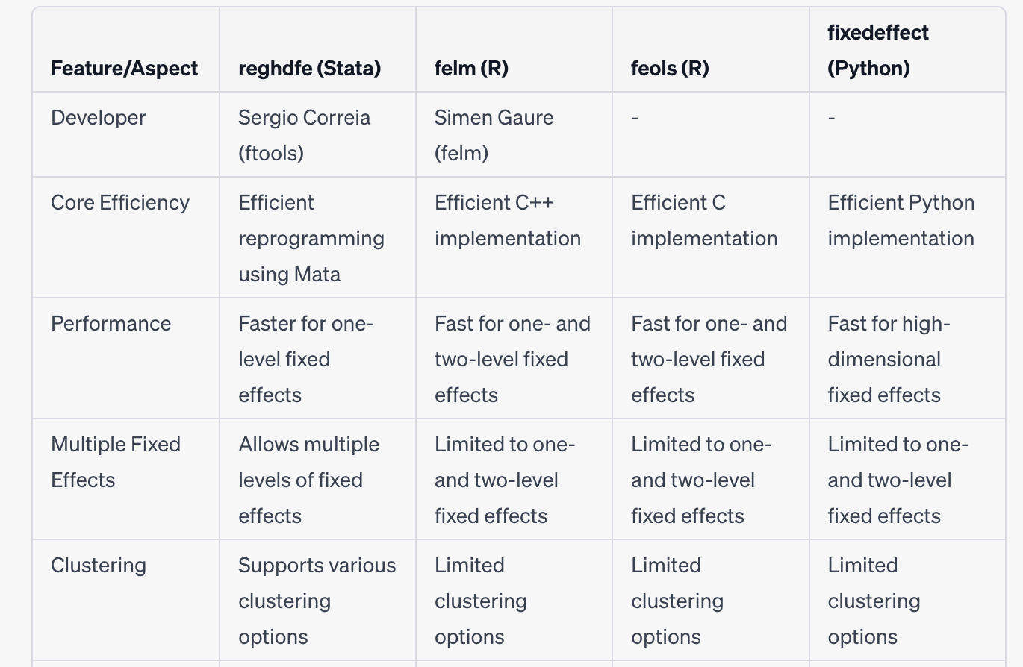
Package Comparison

Slide 9
Data Example
Dataset on Madison, WI home sales (Hendel et al. 2009)
Research Question: Are realized prices higher when using a realtor, or when sold by owner themselves?
Potential for selection?
Solution: home fixed effects – only use within-home comparisons!
Contains 22,000 home sales and 16,000 fixed effects

Slide 10





Stata Fixed Effect Models – KLC Run Time
reg log_sale_price list_fsbo age_home new i.month year i.home_id,
cluster(home_id)
areg log_sale_price list_fsbo age_home new i.month year, absorb(home_id) cluster(home_id)
xtreg log_sale_price list_fsbo age_home new i.month year, fe cluster(home_id)
reghdfe log_sale_price list_fsbo age_home new i.month year, absorb(home_id)
vce(cluster home_id)
Did not Run
0.32 seconds
0.09 seconds
0.10 seconds

Slide 11
R Fixed Effect Models - Run Time
lm( log_sale_price~ list_fsbo+ new + as.factor(month) + as.factor(home_id), data=homes_data)
library(lfe)
felm(log_sale_price ~ list_fsbo + age_home + new + as.factor(month) + year
| home_id | 0 | home_id , data=homes_data)
library(fixest)
feols(log_sale_price ~ list_fsbo + age_home + new + as.factor(month) + year | home_id)
57
minutes
0.16
seconds
0.05
seconds

Slide 12
Python Fixed Effect Model - Run Time
fixedeffect(data_df = homes_data, dependent = log_sale_price, exog_x = ['list_fsbo', 'age_home', 'new'], category = ['home_id', 'month'], cluster = home_id)
0.37 seconds

Slide 13
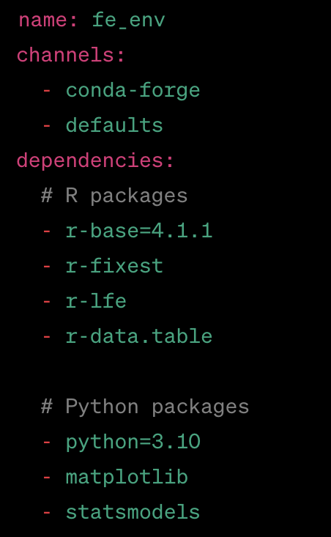
Creating a Fixed Effect Conda Environment
Using a text editor, create the following file on KLC called fe_env.yml
You can run this file using the mamba module on KLC to create the environment
module load mamba
mamba env create -f fe_env.yml
source activate fe_env
pip install FixedEffectModel

Slide 14
Activating a Conda Environment
To activate the environment in the future, either load mamba:
module load mamba
OR any version of conda:
module load python-anaconda3/2019.10
Then run this line to activate the environment:
source activate fe_env
To leave the environment:
source deactivate fe_env
To output the yaml file so you can share your environment with others:
conda env export > fe_env.yml

Slide 15
Discussion
Do we really need to create a conda environment for this?
Should we have specified package versions in the yaml file used to install this?
When you run fixed effects or any other type of regressions on KLC:
What is your workflow?
What problems do you encounter?
Will you do anything differently now? (get back to this)

Slide 16
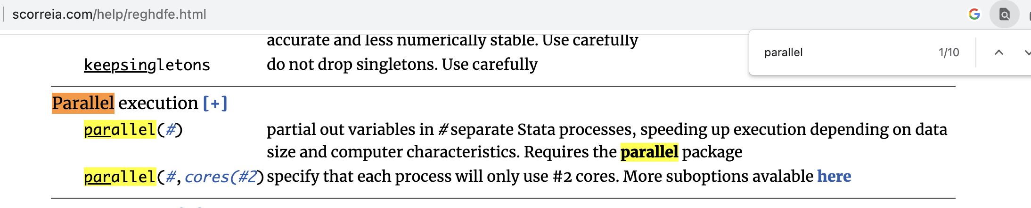
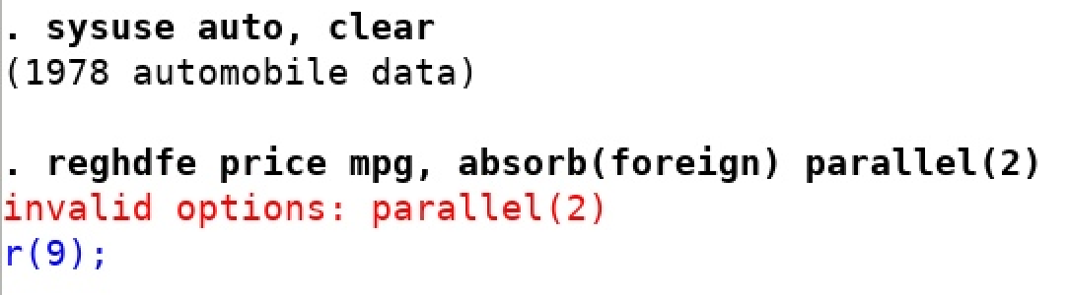
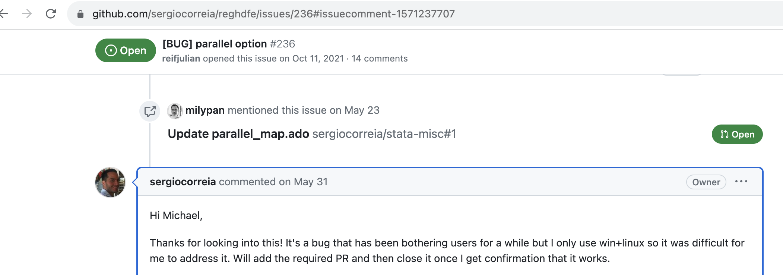
Version Control – A Cautionary Tale
To parallelize reghdfe the Stata documentation describes a “parallel” option:
However, this no longer runs in Stata 17:
Developer’s response:

Slide 17
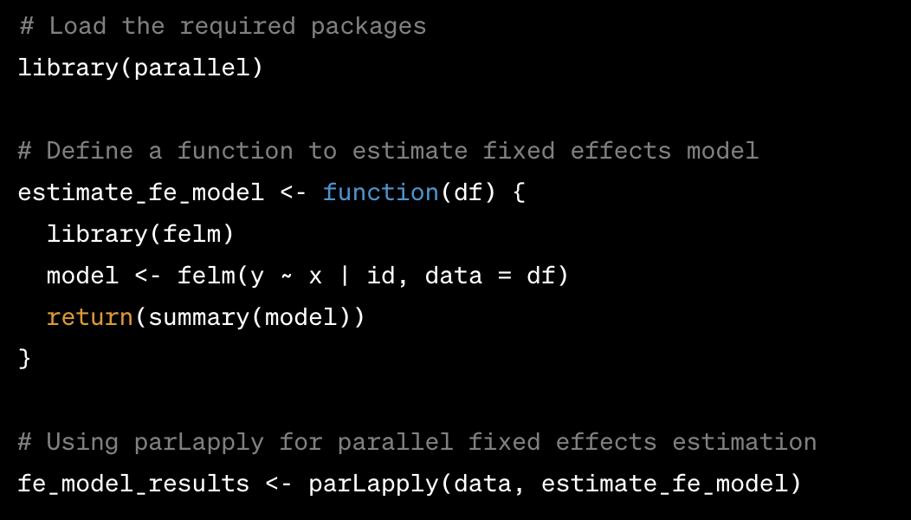
HD Fixed Effect Parallelization in R
Overview:
parallel library accelerates R computations by enabling simultaneous execution of tasks on multiple CPU cores.
Key Features:
parLapply: parallelizing tasks that require significant computation or when data needs to be shared across cores.
mclapply: Suited for scenarios with minimal data sharing and when independent tasks can be executed in parallel.

Slide 18
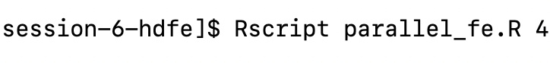
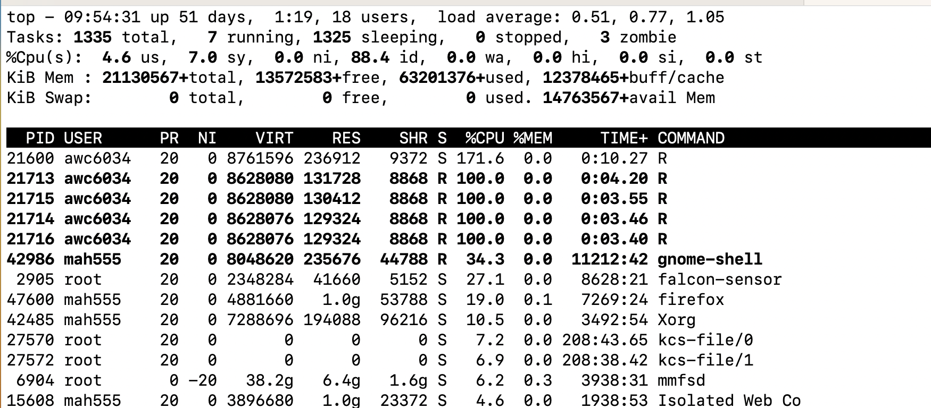
Demo – FE Parallelization on KLC

Slide 19
Parallelization Checklist on KLC
Do I understand what I’m parallelizing?
Is it something completely separable: embarrassingly parallel
Is it something that needs to be shared: task or data parallel, etc.
Do I understand how parallelization works for my package?
Are those resources available? Number of cores, amount of memory?
How can I monitor whether those resources stay available?
Is my parallelization doing what I want?
For instance, did I run the same regression 4 times on different cores, instead of parallelizing it on 4 cores
Did I accidentally grab all the cores?
Am I stuck on one core?
Did I do something to make the node unstable?

Slide 20
Discussion - Revisited
Do we really need to create a conda environment for this?
Should we have specified package versions in the yaml file used to install this?
When you run fixed effects or any other type of regressions on KLC:
What is your workflow?
What problems do you encounter?
Will you do anything differently now?

Slide 21
HD Fixed Effect Example Studies
Environmental Economics
Study: Impact of Green Regulations on Firm Emissions
Method: Fixed effects control for unobserved firm-specific characteristics and regulatory effects.
Labor Economics
Study: Gender Wage Gap Over Time
Method: Fixed effects capture gender-specific wage differentials by controlling for time-invariant factors.
Health Economics
Study: Effects of Universal Healthcare on Health Outcomes
Method: Fixed effects account for unobserved health-related characteristics and policy impacts.
Finance
Study: Determinants of Stock Returns Across Industries
Method: Fixed effects control for industry-specific factors influencing stock performance.

Slide 22
Takeaways:
High-Dimensional Fixed Effects are a widely used method to alleviate omitted variable bias / account for potential unobserved heterogeneity
Efficient/feasible algorithms (using Frisch-Waugh-Lovell-motivated de-meaning) are available in all common languages
Consider not just speed, but also flexibility/adaptability
Clustering (can you cluster at level different from fixed effect?)
Multiple fixed effects (ongoing econometric progress in this area)
‘Within-group’ nature of de-meaning naturally lends itself to parallelization

Slide 23
Proof

Slide 24
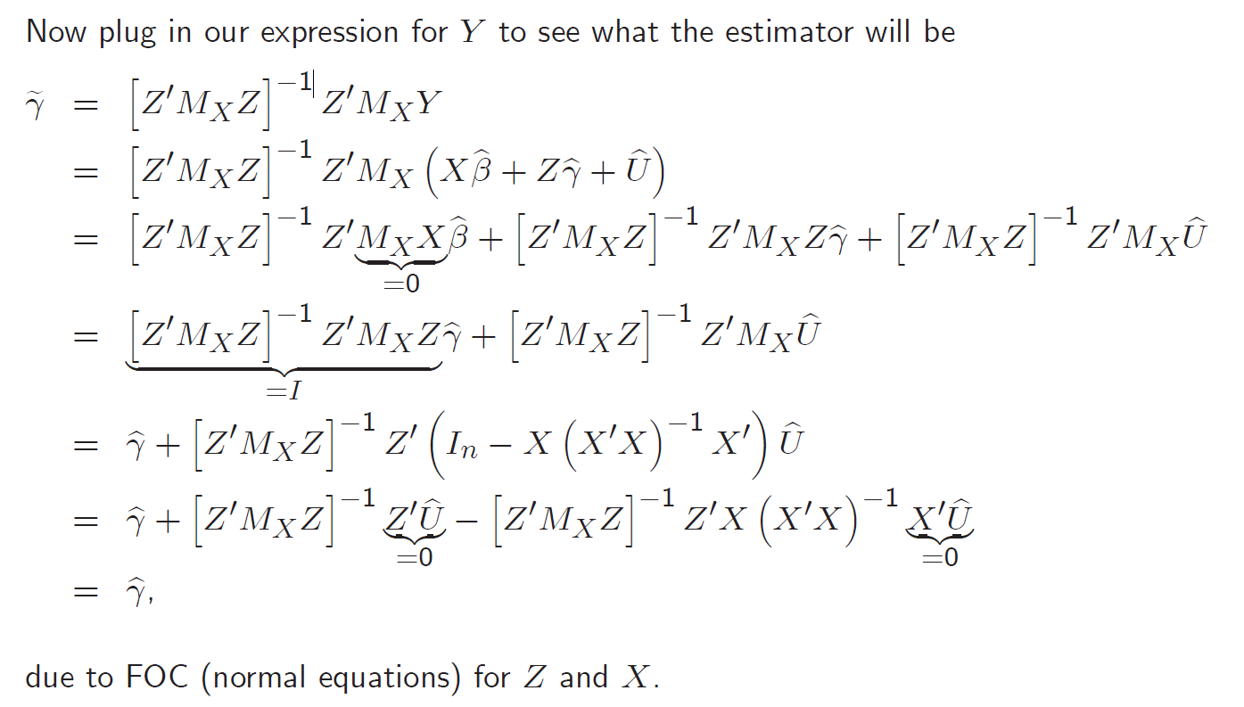
Proof – Cont’d

